Slide 1
Freshman RPG
Existing Functionality

Slide 2
Overview
What is the Freshman RPG?
RPG = Role Playing Game
Goal: Introduce freshmen to the university with a game that mimics certain activities and locations on campus
Currently targeted to Engineering students
Can be used to introduce topics mentioned in First Year Seminar
It’s a world where a freshman can explore with their classmates

Slide 3
Main Features
Control a character in the game
Explore a virtual version of Shippensburg University
Interact with the environment
Chat with other players and in-game characters
Complete objectives both in and outside the game

Slide 4
CONTROL
alt delete

Slide 5


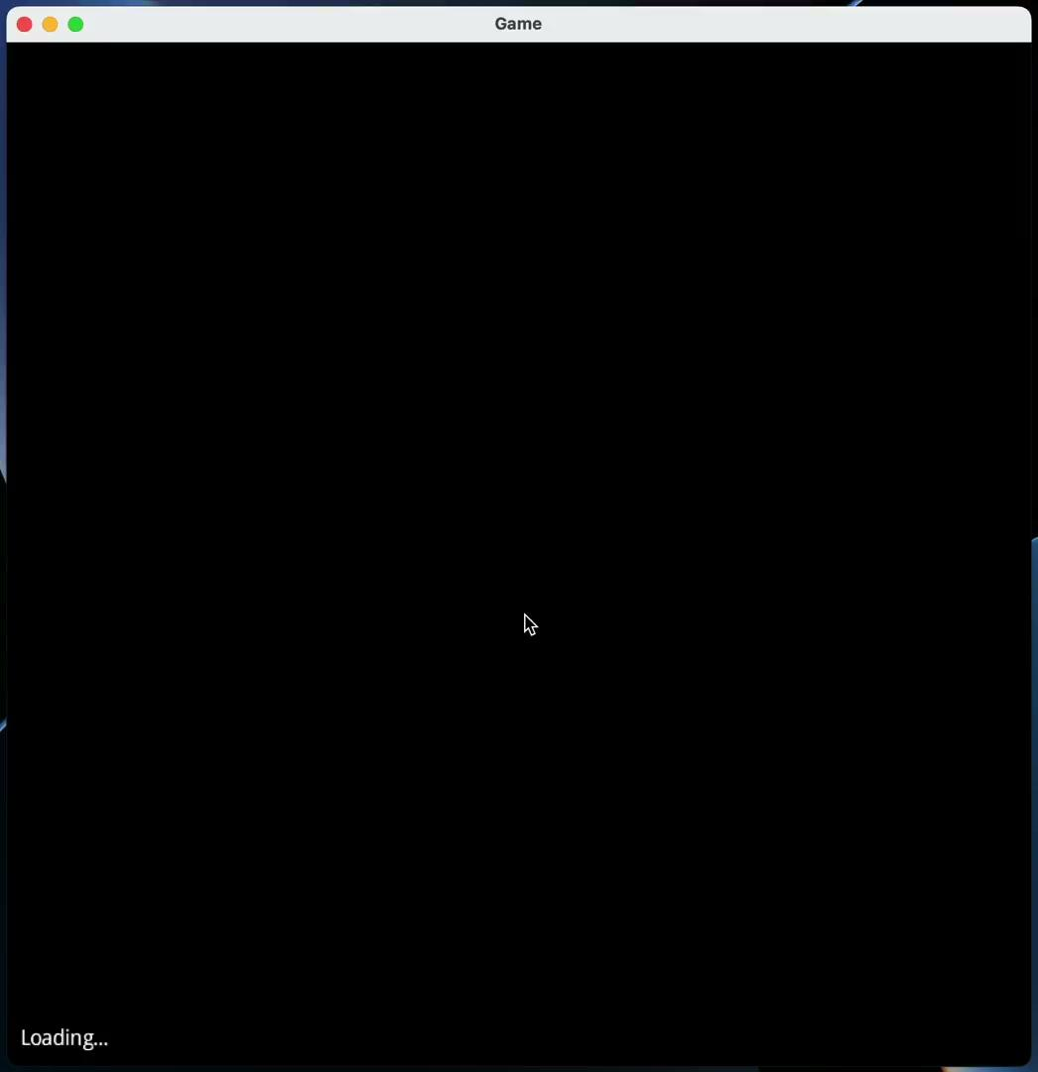
Control Character
Be a person in the world
Walk around and see the sights!
These characters
are color-coded
by their crew

Slide 6
EXPLORE
I can show you the world!

Slide 7
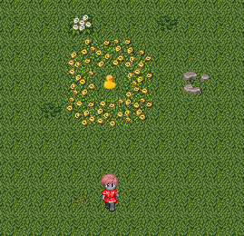
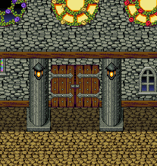

Exploring the World
Multiple ways to travel to new locations!

Slide 8
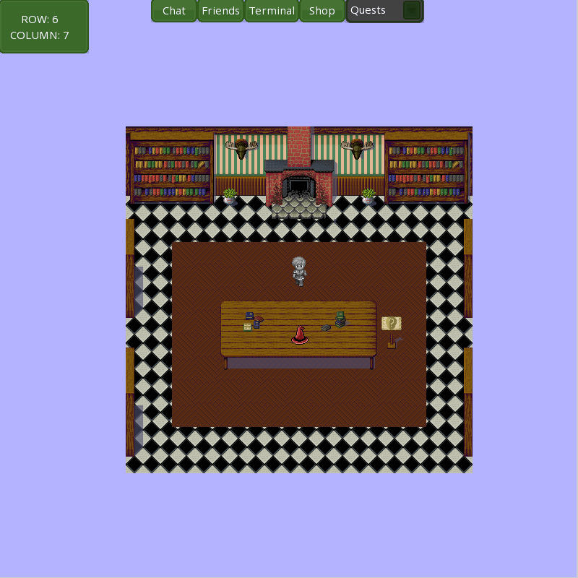
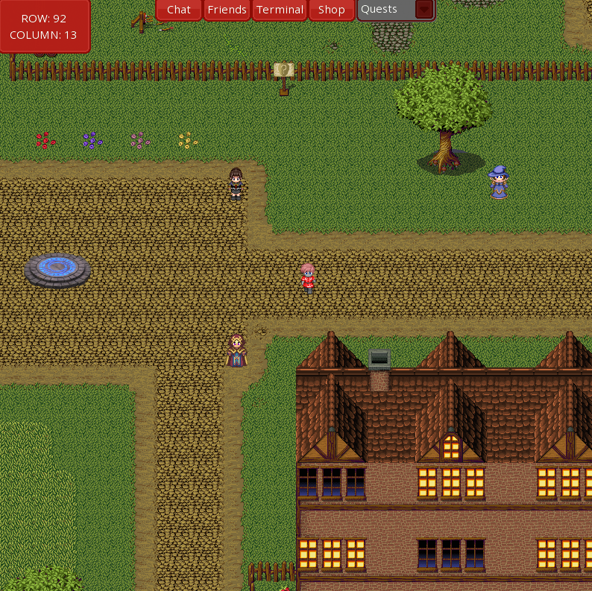
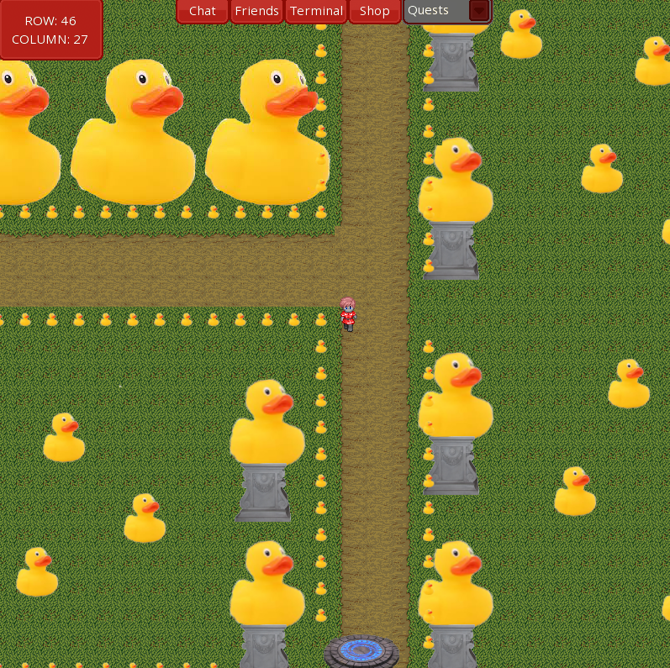
The World
Current
Quiznasium
Study Hall
Sorting Room
Wellington Room
MCT Room
The Green
Ducktopia
CUB+

Slide 9
INTERACT
Press ‘E’ to interact

Slide 10

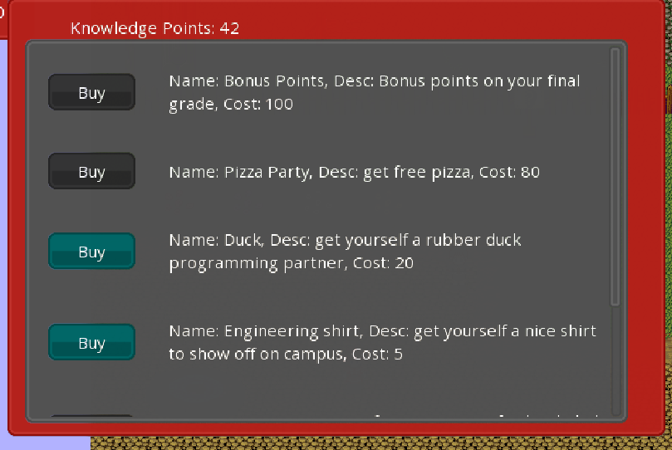
Interacting with the World
Pick flowers!
Talk to people
Shop

Slide 11
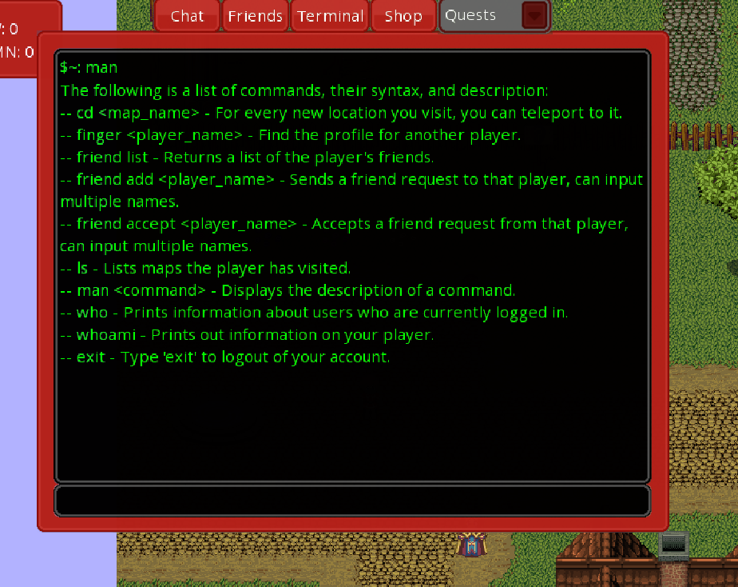
Additional Interactions
Terminal
Interact with players and the environment with special commands

Slide 12
CHAT
Can you hear me now?

Slide 13



Non-Player Characters (NPCs)
Variety of NPCs to interact with
Sorting Hat, RandomFacts, QuizBot, etc.

Slide 14
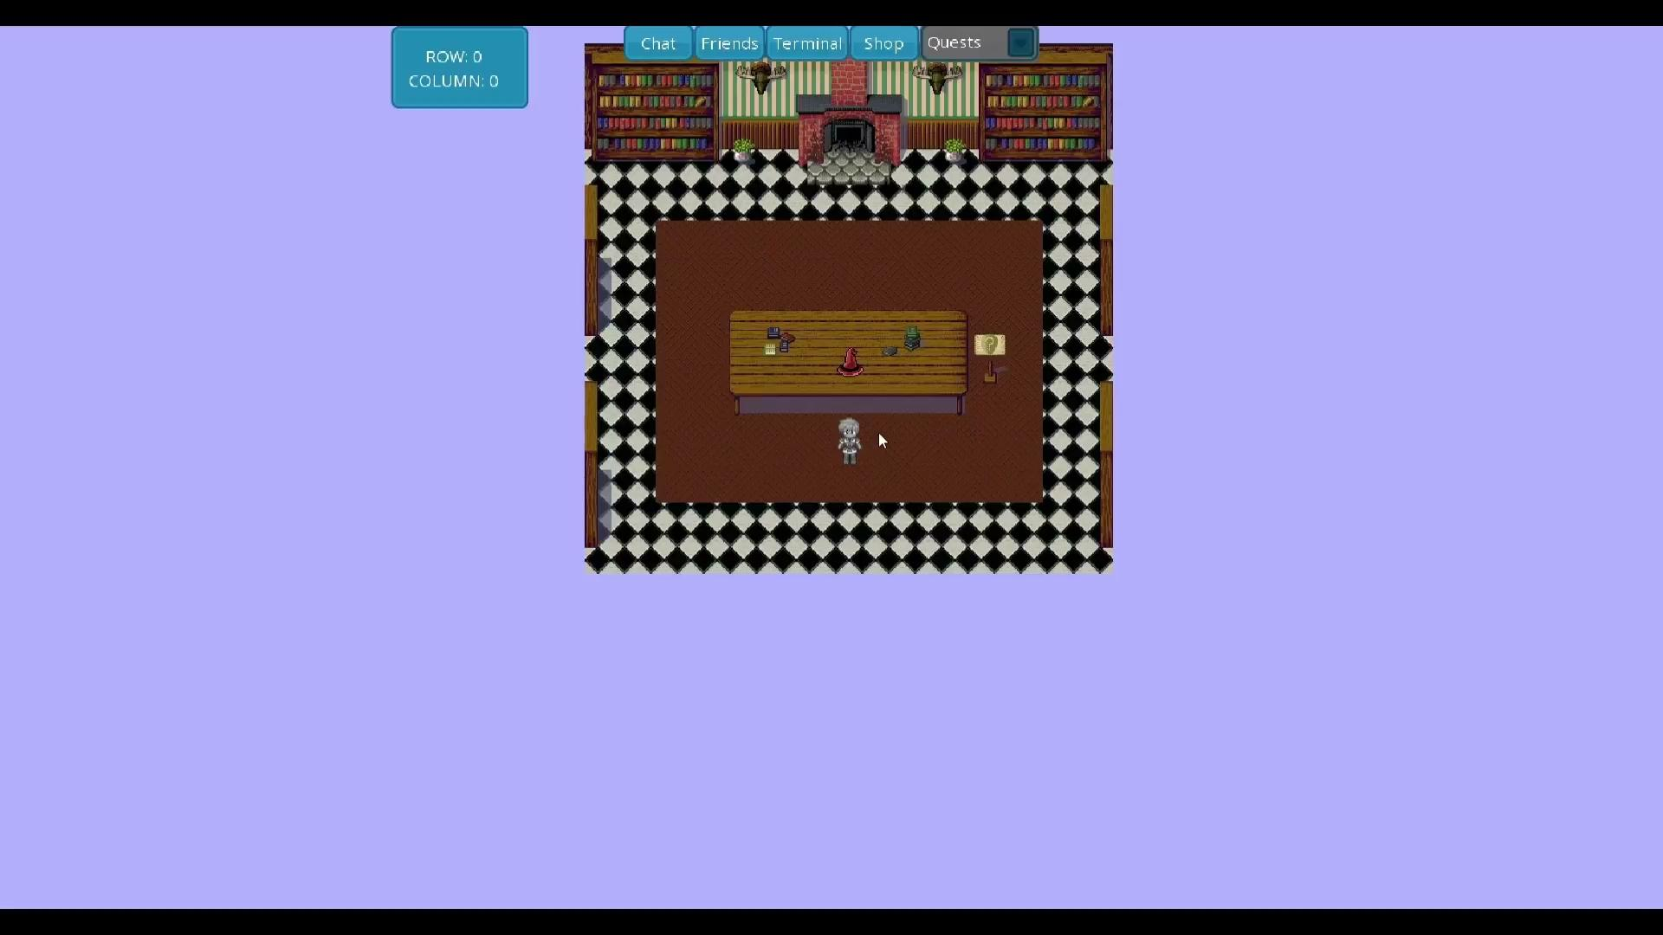

Slide 15
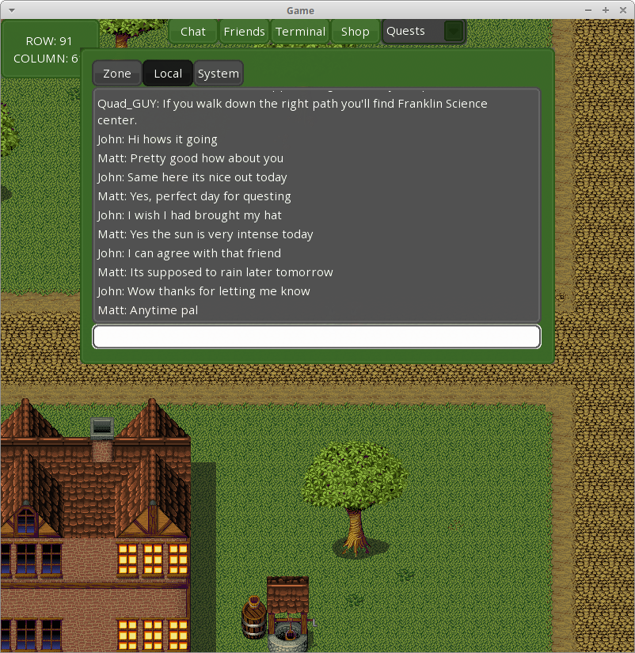
In-Game Chat
Chat with your buddies!
Or make new ones!
Communicate with anyone on your map

Slide 16
QUESTS
It’s dangerous to go alone

Slide 17
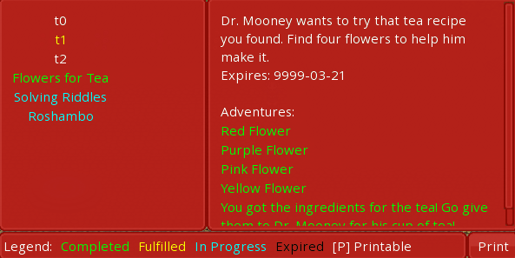
What are Quests?
Quests are a series of adventures you must complete
Once all adventures are completed, the quest is complete

Slide 18
Just to Recap…
Our goal of the Freshman RPG is to introduce freshmen to the university with a game that mimics certain activities and locations on campus
Targeted to the School of Engineering
Can be reworked to be more accessible for students in First-Year Seminar
In its current state, users can:
Control a character
Explore and interact with the virtual world
Communicate with other players
Complete events

Slide 19
TIME FOR QUESTIONS!

